Slide 1
Date : 14th and 15th Nov 2012 Dibyendu Bhattacharya Principal Software Engineer EMC
Hadoop Training

Slide 2
Agenda
Why Hadoop
Hadoop Basic Concept
Map Reduce Programming Paradigm
Hadoop Deep Dive
Map Reduce Deep Dive
Setting up Hadoop Cluster
Hadoop Hands on
Hadoop Advanced Programming
Hadoop Eco System
Beyond Hadoop

Slide 3
Agenda
Why Hadoop
Hadoop Basic Concept
Map Reduce Programming Paradigm
Hadoop Deep Dive
Map Reduce Deep Dive
Setting up Hadoop Cluster
Hadoop Hands on
Hadoop Advanced Programming
Hadoop Eco System
Beyond Hadoop

Slide 4
Why Hadoop
Introduction to Distributed Computing
Parallel vs Distributed Computing
Parallelization and Synchronization
Networking Primitives

Slide 5
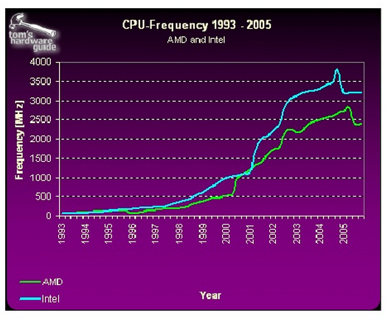
Computer Speedup
Moore’s Law : Density of transistors in a chip doubles ever 18 month at same cost.
Graph get flatten up at the end .. Why ?

Slide 6
Traditional Large Scale System
For decades, the primary push was to increase the computing
power of a single machine
Faster processor, more RAM
Parallel Computing
Distributed systems evolved to allow developers to use multiple machines for a single job

Slide 7
Brief History..1975-1985
Parallel Computing favored in early years
Primarily Vector-based at first
More thread based parallelism introduce

Slide 8
Brief History..1985-1995
Massively parallel architecture start rising.
Library like Message Passing Interface (MPI) getting developed.
Network Bandwidth was a big problem

Slide 9
Brief History..1995-Today
Cluster Grid Architecture become dominant
Usage of Commodity Computers for Super Computing Platform

Slide 10
Parallel vs. Distributed Computing
Parallel Computing Mean
Vector Processing of Data
Thread based parallelism
Distributed Computing is multiple CPU across multiple Computer connected over the Network.

Slide 11
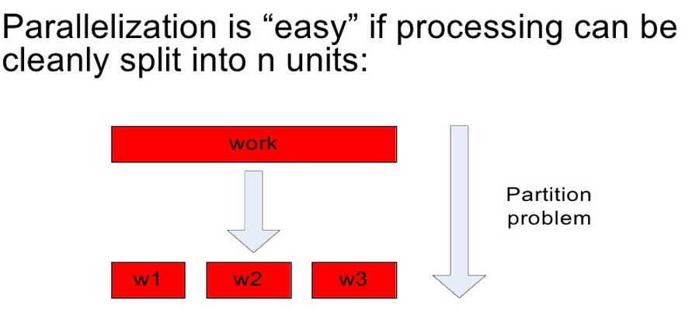
Parallelization and Synchronization
Parallelization Idea

Slide 12
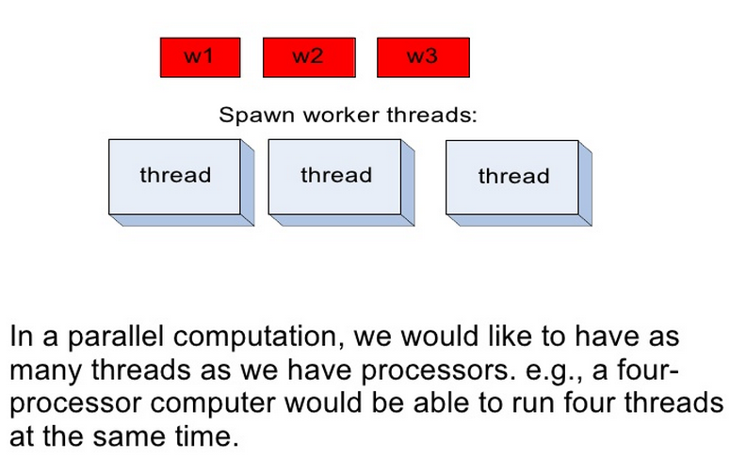
Parallelization and Synchronization
Parallelization Idea

Slide 13
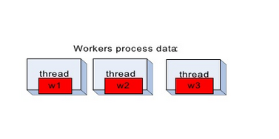
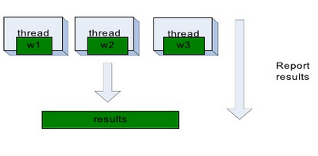
Parallelization and Synchronization
Parallelization Idea

Slide 14
Parallelization pitfall
How we assign work units to threads ?
What if there are more work units than threads ?
How do we aggregate the result at the end ?
How do we know all workers are finished ?
What if work can not divided into separate task ?
What is the common theme all these problems ?

Slide 15
Parallelization pitfall
Communication Problem !!
At some point each of these threads needs to communicate with each other or access a shared system.
Any memory accessed by multiple thread needs to have associated synchronization system

Slide 16
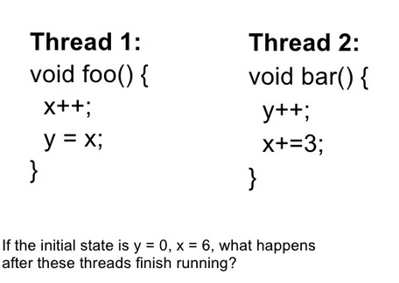
Multithreaded = Unpredictability

Slide 17
Multithreaded = Unpredictability
Pulling work unit from Queue
Reporting work back to master unit
Telling another thread that it start next phase…
All need synchronization ! And synchronization is Hard !
Need to have synchronization primitives, Conditional Variable.
Shared state is problem …
Need a framework which does all locking transparently and provide a Shared Nothing Programming Paradigm.

Slide 18
Distributed Computation
Have to take into account the Network !
Why ?
If a Computer Disconnect, what that mean ?

Slide 19
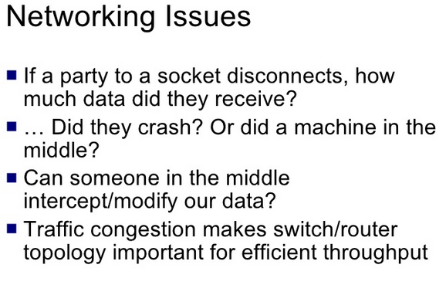
Distributed Computation

Slide 20
Distributed System : Problems
Programming for traditional distributed systems is complex
– Data exchange requires synchronization
– Finite bandwidth is available
– Temporal dependencies are complicated
– It is difficult to deal with partial failures of the system

Slide 21
Distributed System : Data Storage
Typically, data for a distributed system is stored on a SAN
At compute time, data is copied to the compute nodes
Fine for relatively limited amounts of data
What will be the problem for Big Data ?

Slide 22
World full of Data
Modern systems have to deal with far more data than was the case in the past
Organizations are generating huge amounts of data
That data has inherent value, and cannot be discarded
Examples:
Facebook – over 70PB of data
eBay – over 5PB of data
Many organizations are generating data at a rate of terabytes per day

Slide 23
Data Become the Bottleneck
Moore’s Law has held firm for over 40 years
Processing power doubles every two years
Processing speed is no longer the problem
Getting the data to the processors becomes the bottleneck
Quick calculation
Typical disk data transfer rate: 75MB/sec
Time taken to transfer 100GB of data to the processor: approx. 22 minutes!
A new approach is needed

Slide 24
What is the Solution
We can process data very quickly but we can read/write it very slowly
distribute the data
Reading 100 GB off a single filer would leave nodes starved – just store data locally
Solution: parallel reads
1 HDD = 75 MB/sec
1000 HDDs = 75 GB/sec
Now you’re talking!

Slide 25
Requirement for New Approach
Support partial failure
Total system must support graceful degradation in application performance rather than a full halt
Data Recoverability
If components fail, their workload must be picked up by still-functioning units
Individual Recoverability
Nodes that fail and restart must be able to rejoin the group activity without a full group restart
Consistency
Concurrent operations or partial internal failures should not cause externally visible non determinism

Slide 26
A New way out ..
Nodes talk to each other as little as possible – maybe never
“Shared nothing” architecture
Programmer should not explicitly be allowed to communicate between nodes
Data is spread throughout machines in advance, computation happens where it’s stored.

Slide 27
Hadoop History
Hadoop is based on work done by Google in the late 1990s/early 2000s
Specifically, on papers describing the Google File System (GFS) published in 2003, and MapReduce published in 2004
This work takes a radical new approach to the problem of distributed computing
Meets all the requirements we have for reliability and scalability
Core concept: distribute the data as it is initially stored in the system
Individual nodes can work on data local to those nodes
No data transfer over the network is required for initial processing

Slide 28
Core Hadoop Concept
Applications are written in high-level code
Developers need not worry about network programming, temporal dependencies or low-level infrastructure
Nodes talk to each other as little as possible
Developers should not write code which communicates between nodes
‘Shared nothing’ architecture
Data is spread among machines in advance
Computation happens where the data is stored, wherever possible
Data is replicated multiple times on the system for increased availability and reliability

Slide 29
Agenda
Why Hadoop
Hadoop Basic Concept
Map Reduce Programming Paradigm
Hadoop Deep Dive
Map Reduce Deep Dive
Setting up Hadoop Cluster
Hadoop Hands on
Hadoop Advanced Programming
Hadoop Eco System
Beyond Hadoop

Slide 30
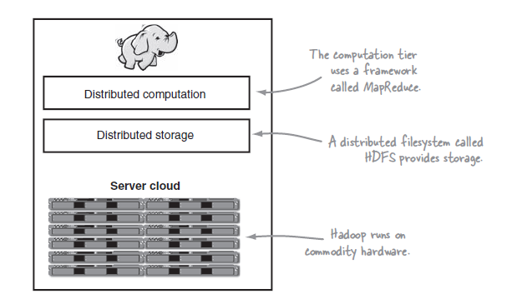
Hadoop Environment

Slide 31
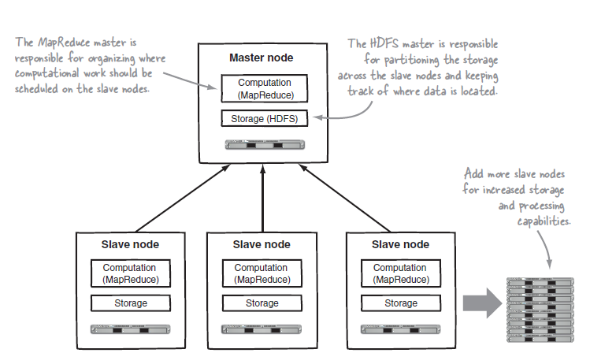
Hadoop Master Slave Architecture

Slide 32
Hadoop Distributed File System
Why you need a file system ?
Why you need a Distributed File System ?

Slide 33
Hadoop Distributed File System
The Hadoop Distributed File System (HDFS) provides global access to ﬁles in the cluster
For maximum portability and ease of installation, HDFS is implemented as a user-level ﬁle system in Java which exploits the native ﬁle system on each node, such as ext3 or NTFS, to store data.
HDFS is optimized for large, streaming reads of files
Rather than random reads
A simple coherence model (write-once, read-many) is used that does not allow data to be modiﬁed once written

Slide 34
Hadoop Distributed File System
HDFS is heavily optimized for high throughput and works best when reading and writing large files (gigabytes and larger)
To support this throughput HDFS leverages unusually large (for a file system) block sizes and data locality optimizations to reduce network input/output (I/O)
each ﬁle in HDFS is divided into large blocks for storage and access, typically 64MB in size

Slide 35
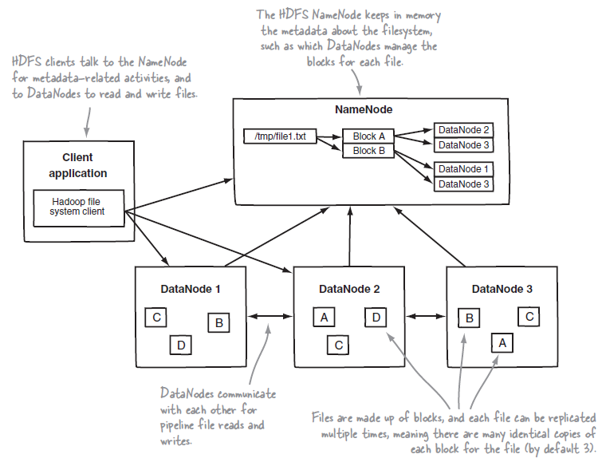
HDFS
HDFS is implemented by two services: the NameNode and DataNode

Slide 36
HDFS NameNode
The NameNode daemon must be running at all times
If the NameNode stops, the cluster becomes inaccessible
Your system administrator will take care to ensure that the NameNode hardware is reliable!
The NameNode holds all of its metadata in RAM for fast access
It keeps a record of changes on disk for crash recovery
A separate daemon known as the Secondary NameNode takes care of some housekeeping tasks for the NameNode
Be careful: The Secondary NameNode is not a backup NameNode!

Slide 37
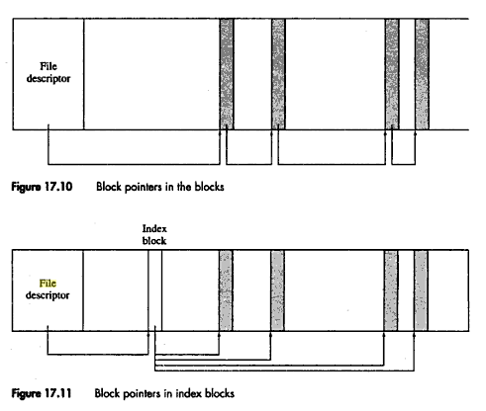
NameNode : Architecture
File System Basics.. What is File Descriptor ? What is iNode ?
What will be the access pattern for below two FD ?

Slide 38
NameNode Architecture
The NameNode maintains the namespace tree and the mapping of blocks to DataNodes.
The inodes and the list of blocks that define the metadata of the name system are called the image. NameNode keeps the entire namespace image in RAM.
The persistent record of the image stored in the NameNode's local native file system is called a checkpoint.
The NameNode records changes to HDFS in a write-ahead log (WAL)called the journal in its local native file system.

Slide 39
NameNode Architecture
Why we need the Write Ahead Log ?

Slide 40
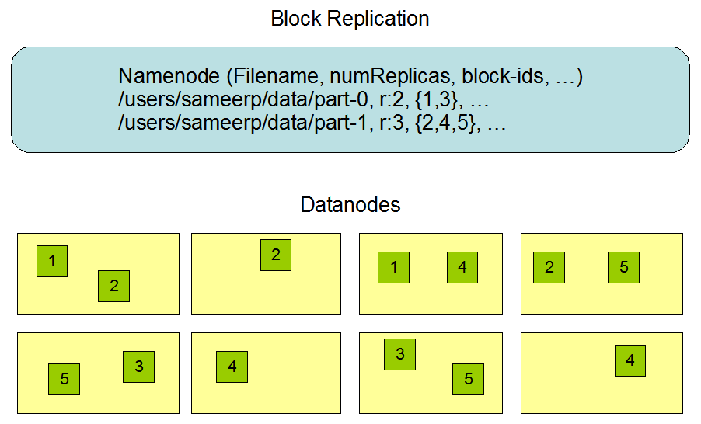
NameNode : Architecture

Slide 41
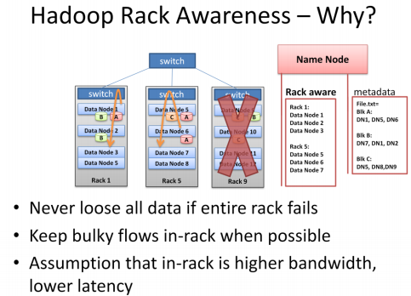
Hadoop Rack Awareness

Slide 42
Data Write
A client request to create a file does not reach the Namenode immediately
HDFS client caches the file data into a temporary local file.
When the local file accumulates a full block of user data, the client retrieves a list of Datanodes from the Namenode.
This list contains the Datanodes that will host a replica of that block.
The client then flushes the data block to the first Datanode.
The first Datanode starts receiving the data in small portions ,writes each portion to its local repository and transfers that portion to the second Datanode in the list.

Slide 43
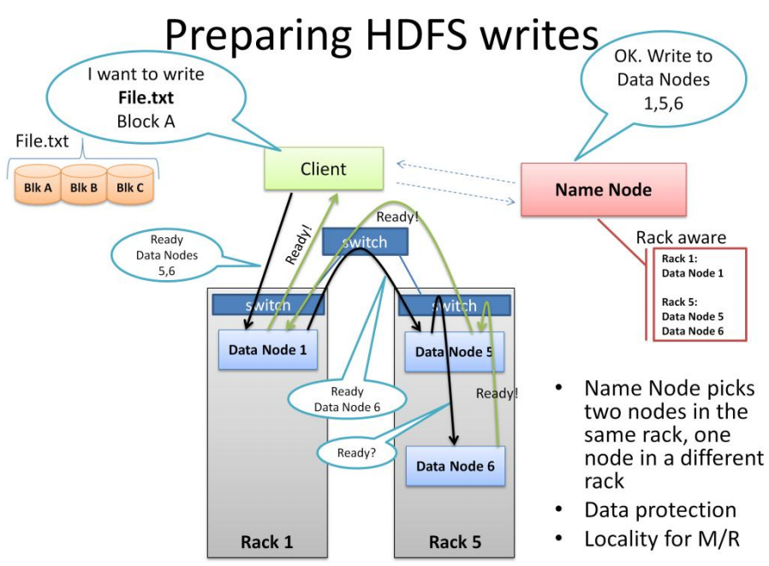
Data Write

Slide 44
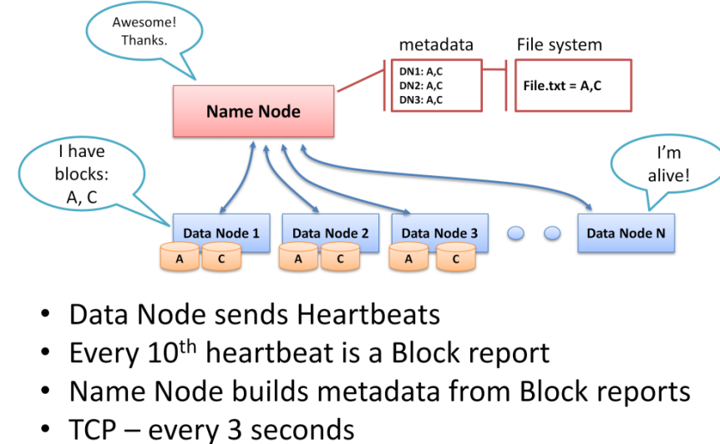
Block Report

Slide 45
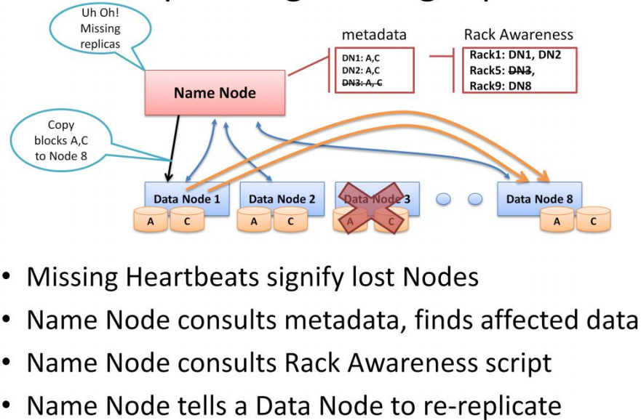
Re-Replication

Slide 46
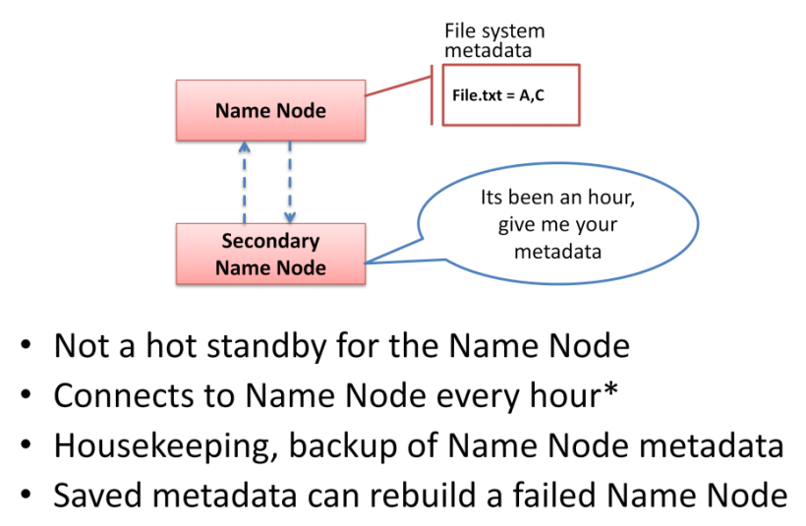
Secondary Name Node

Slide 47
File Read
You have to tell me how read will happen ?

Slide 48
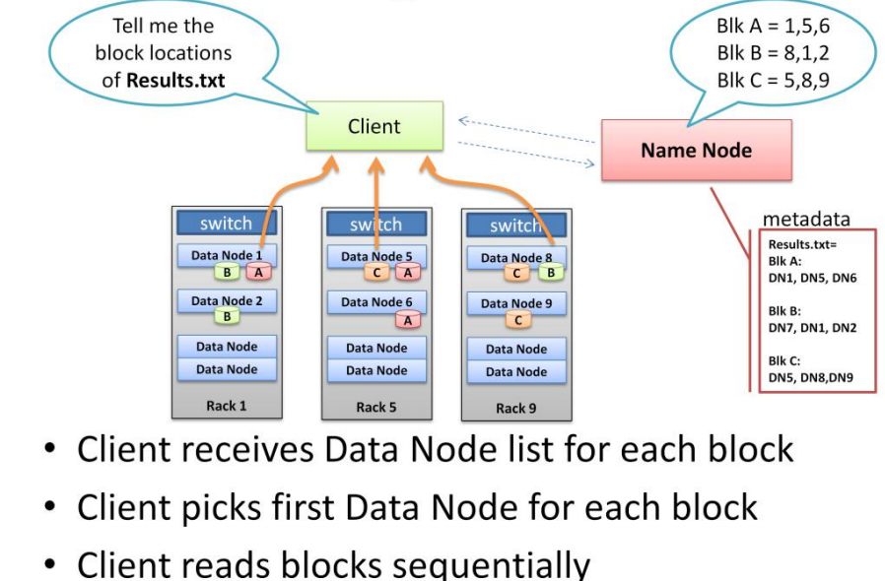
Data Read

Slide 49
File Read
Let Data Node 3 wants to read data block A (in previous slide).
What will be the optimal strategy by Name Node ?

Slide 50
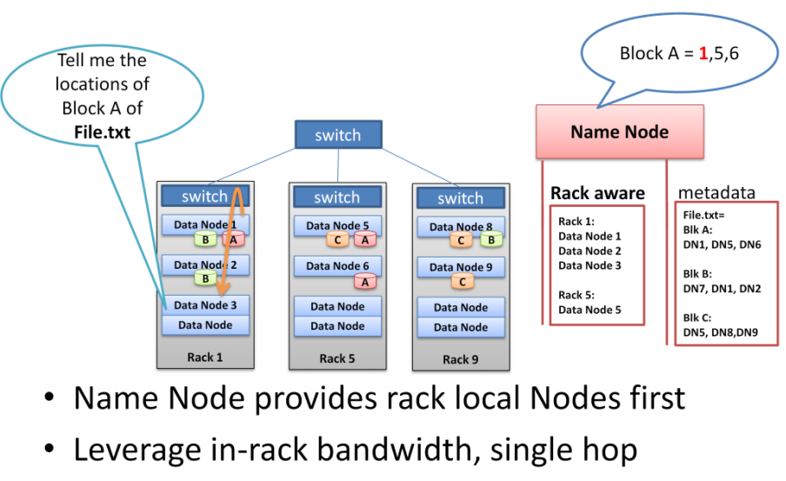
Data Read

Slide 51
Agenda
Why Hadoop
Hadoop Basic Concept
Map Reduce Programming Paradigm
Hadoop Deep Dive
Map Reduce Deep Dive
Setting up Hadoop Cluster
Hadoop Hands on
Hadoop Advanced Programming
Hadoop Eco System
Beyond Hadoop

Slide 52
Functional Programming
FP does not cerate modify Data Structure , they always create new one.
Original Data still exists in unmodified form
Data flow is implicate in program design
Order of operation does not matter

Slide 53
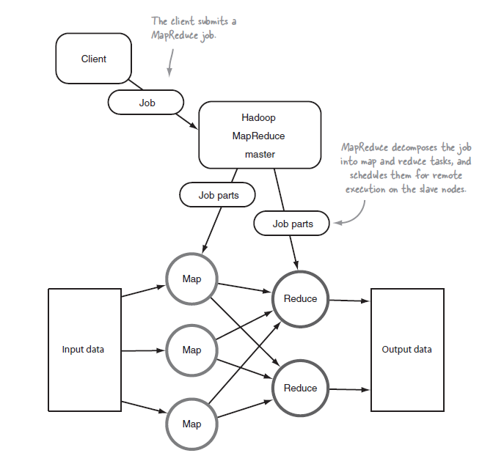
MAP and REDUCE

Slide 54
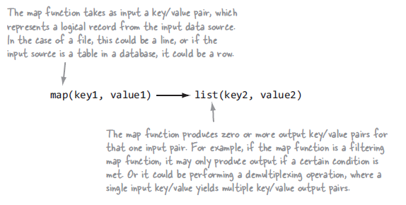
Map Function

Slide 55
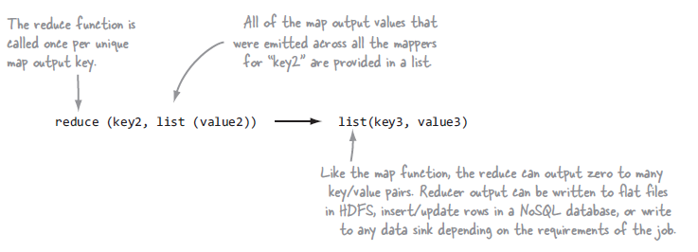
Reduce Function

Slide 56
Reduce Function

Slide 57
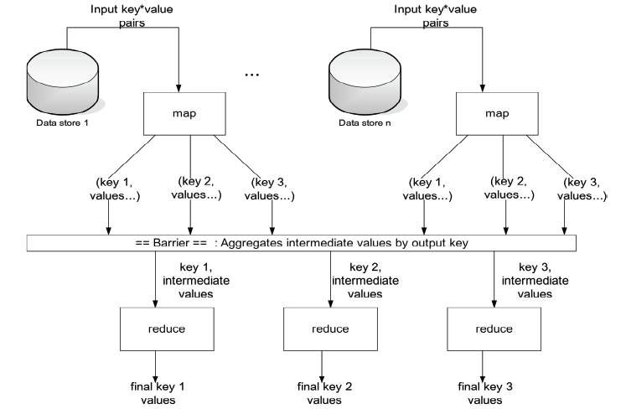
Map Reduce : Whole Picture

Slide 58
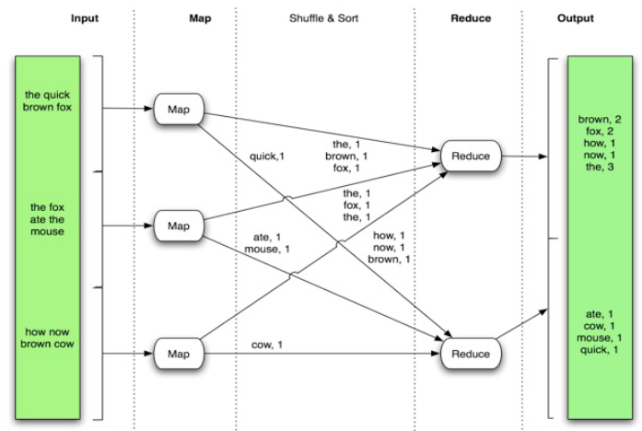
Map Reduce : Example

Slide 59
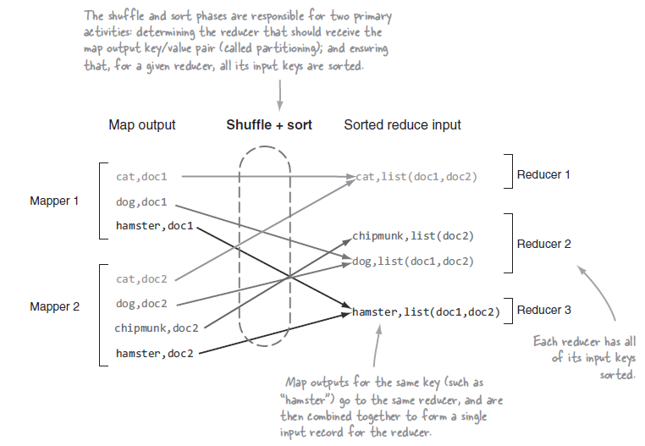
Map Reduce : Example

Slide 60
MapReduce : Terminology
A job is a ‘full program’
A complete execution of Mappers and Reducers over a dataset
A task is the execution of a single Mapper or Reducer over a slice of data
A task attempt is a particular instance of an attempt to execute a task
There will be at least as many task attempts as there are tasks
If a task attempt fails, another will be started by the JobTracker

Slide 61
The Mapper
Hadoop attempts to ensure that Mappers run on nodes which hold their portion of the data locally, to avoid network traffic
Multiple Mappers run in parallel, each processing a portion of the input data
The Mapper reads data in the form of key/value pairs
It outputs zero or more key/value pairs

Slide 62
The Reducer
After the Map phase is over, all the intermediate values for a given intermediate key are combined together into a list
This list is given to a Reducer
There may be a single Reducer, or multiple Reducers
This is specified as part of the job configuration (see later)
All values associated with a particular intermediate key are guaranteed to go to the same Reducer
The intermediate keys, and their value lists, are passed to the Reducer in sorted key order
This step is known as the ‘shuffle and sort’
The Reducer outputs zero or more final key/value pairs
These are written to HDFS

Slide 63
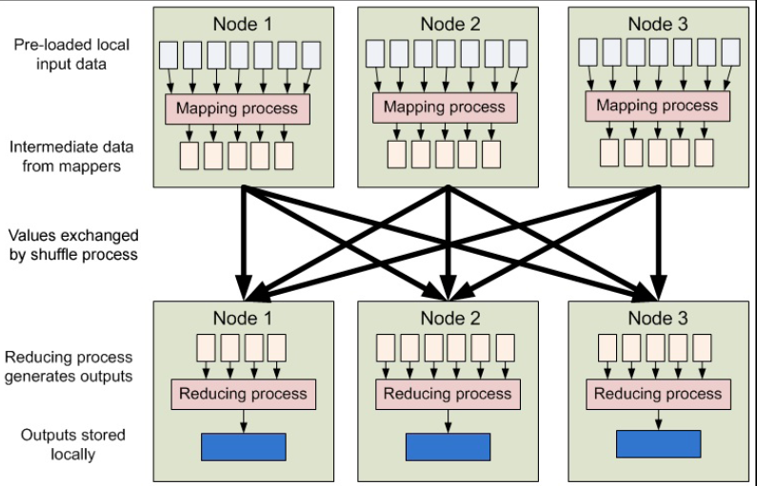
MapReduce : Any bottleneck ?
Did you find any bottleneck in Map Reduce Pipeline?

Slide 64
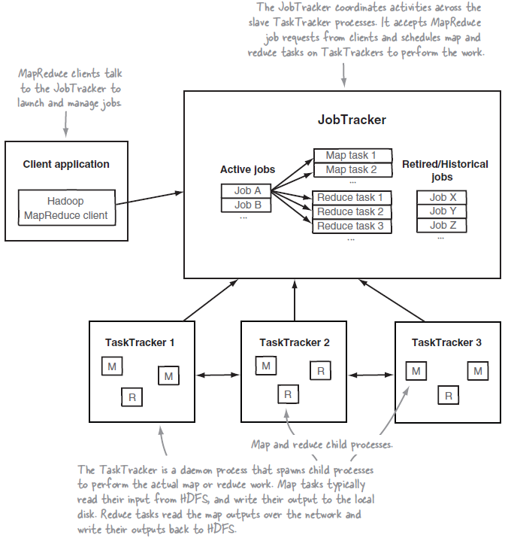
MapReduce : Architecture

Slide 65
Agenda
Why Hadoop
Hadoop Basic Concept
Map Reduce Programming Paradigm
Hadoop Deep Dive
Map Reduce Deep Dive
Setting up Hadoop Cluster
Hadoop Hands on
Hadoop Advanced Programming
Hadoop Eco System
Beyond Hadoop

Slide 66
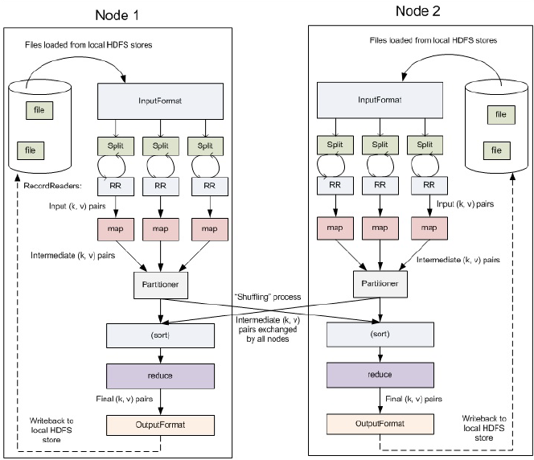
Understanding Input Output in Map Reduce

Slide 67
InputFormat, RecordReader, Splits
Every job in MapReduce must define its Inputs Format
InputFormat implementers must fulfill three contracts
they describe type information for map input keys and values
they specify how the input data should be partitioned
they indicate the RecordReader instance that should read the data from source
Most crucial contract is that of determining how to divide the input data
In MapReduce nomenclature these divisions are referred to as input splits
The input splits directly impact the map parallelism
Number of MAP task = Number for splits
Normally split size = HDFS Block Size
What will happen if the InputFormat not able to split the input data ?

Slide 68
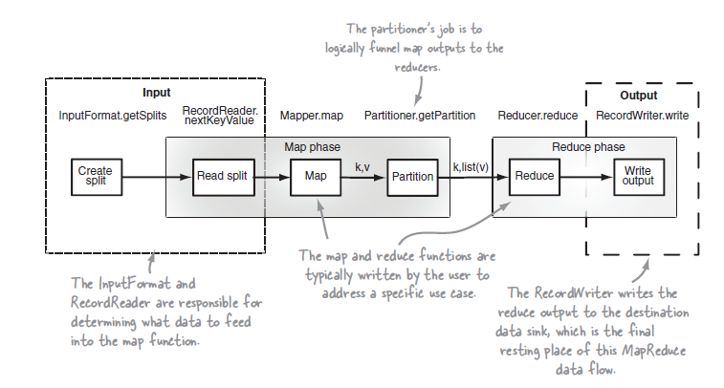
Input Output Actors

Slide 69
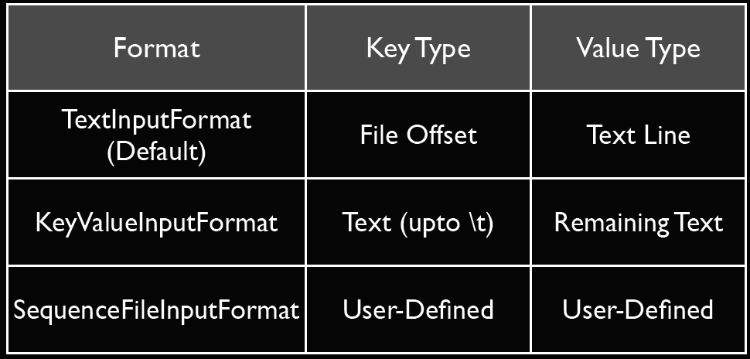
InputFormat

Slide 70
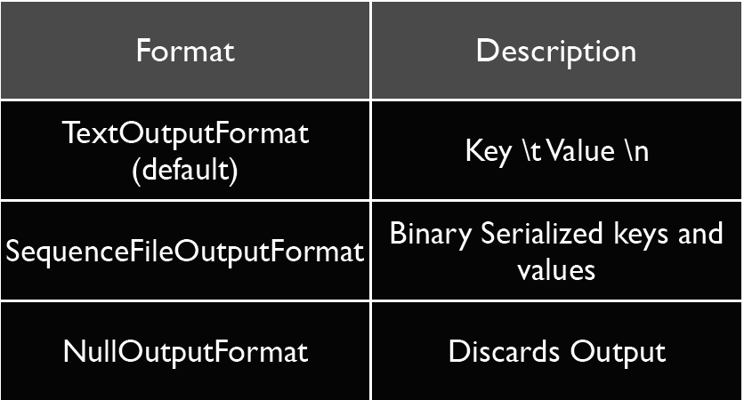
OutputFormat

Slide 71
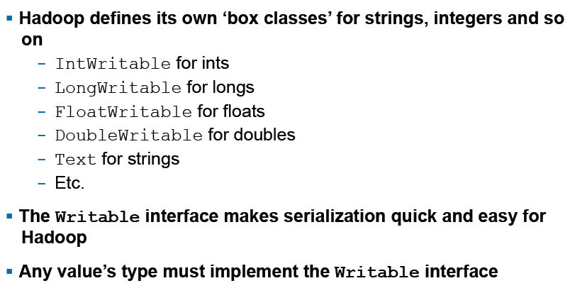
Writable

Slide 72
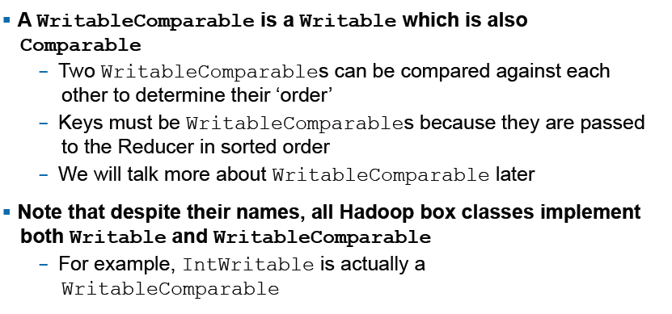
WritableComparable

Slide 73
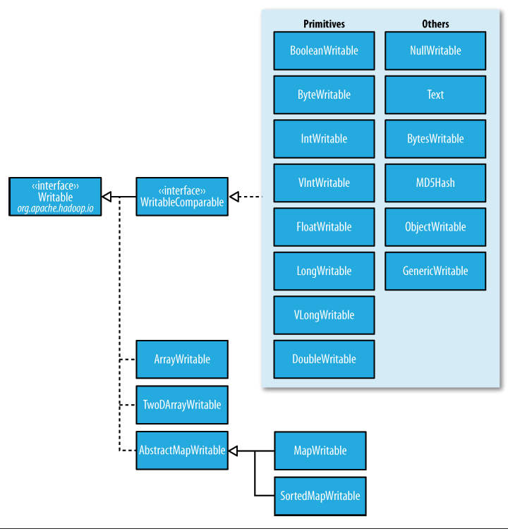
Hadoop Data Types

Slide 74
Demo
It’s the time for a DEMO

Slide 75
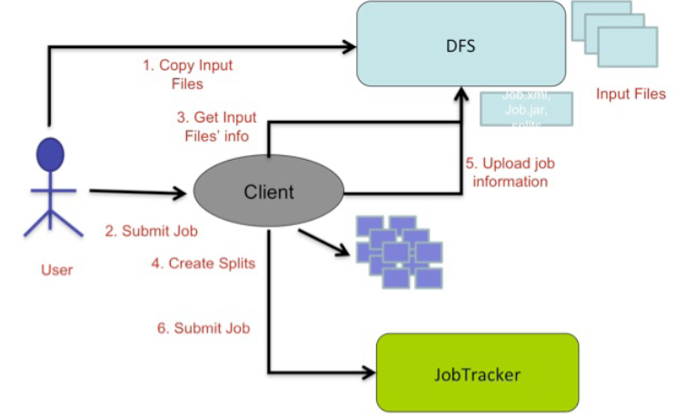
Anatomy of Job Run

Slide 76
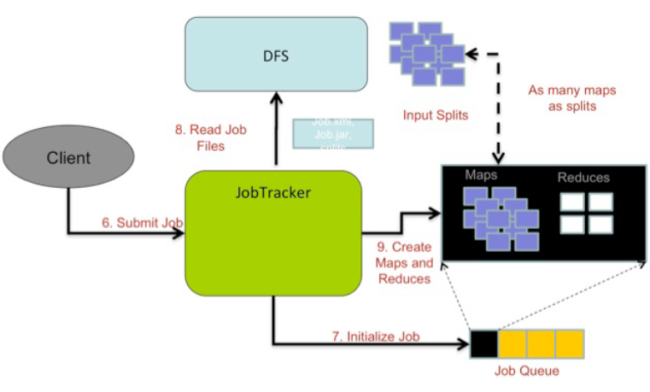
Anatomy of Job Run

Slide 77
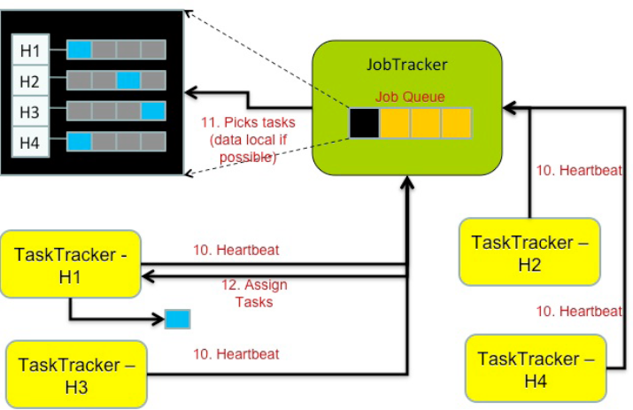
Anatomy of Job Run

Slide 78
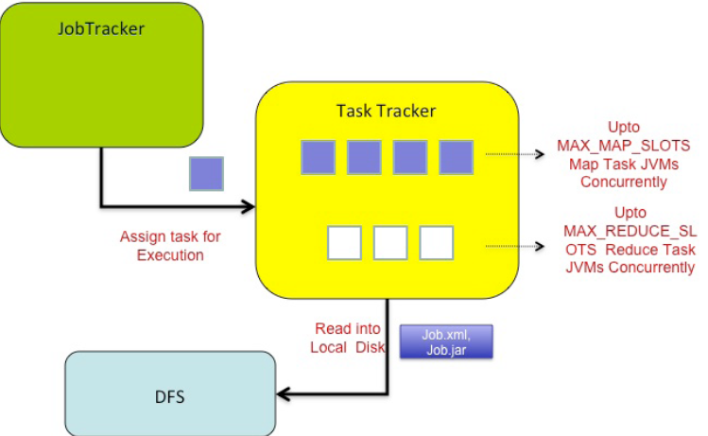
Anatomy of Job Run

Slide 79
Hadoop Job
Do you see any issue in Job Scheduling ?

Slide 80
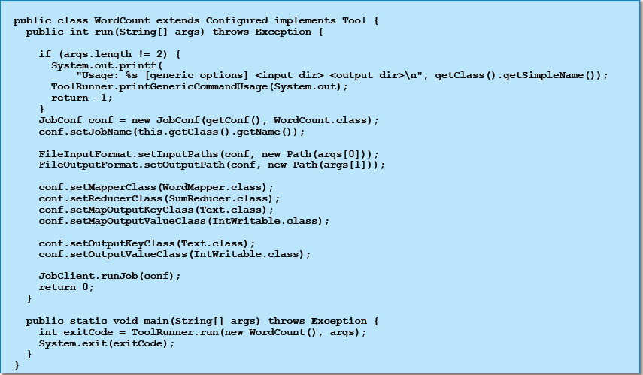
The Driver Class

Slide 81
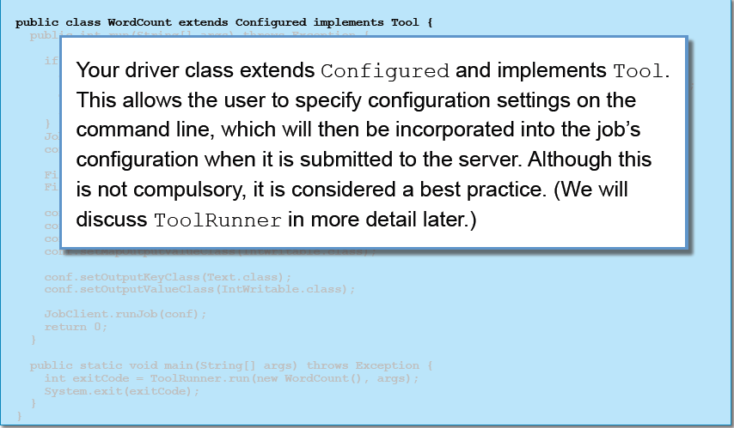
The Driver Class

Slide 82
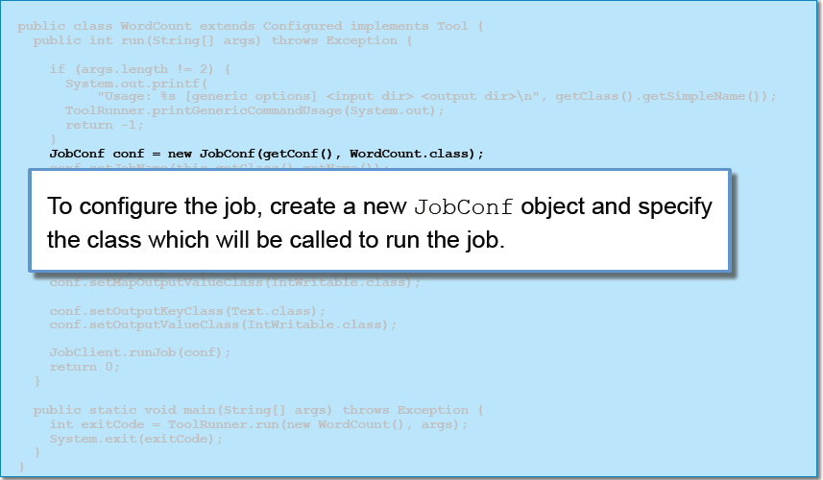
The Driver Class

Slide 83
JobConf
The JobConf class allows you to set configuration options for your MapReduce job
The classes to be used for your Mapper and Reducer
The input and output directories
Many other options
Any options not explicitly set in your driver code will be read from your Hadoop configuration files
Usually located in /etc/hadoop/conf
Any options not specified in your configuration files will receive Hadoop’s default values

Slide 84
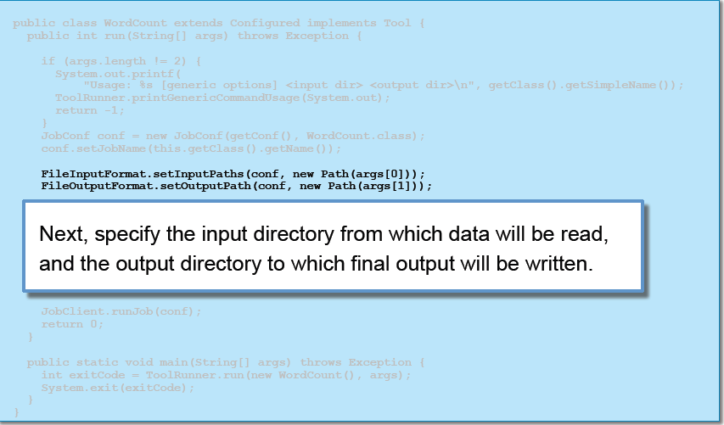
The Driver Class

Slide 85
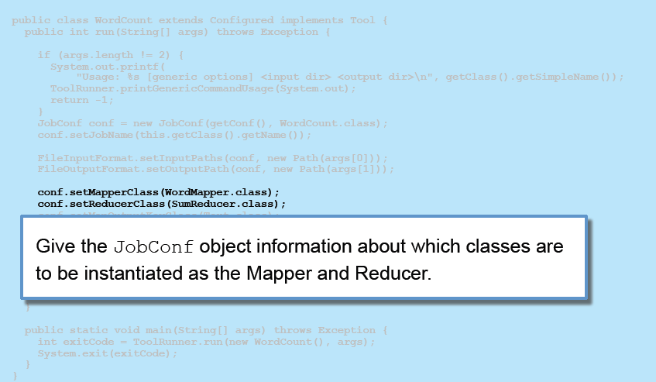
The Driver Class

Slide 86
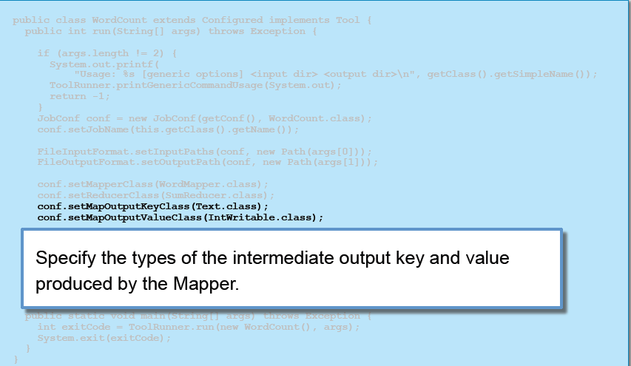
The Driver Class

Slide 87
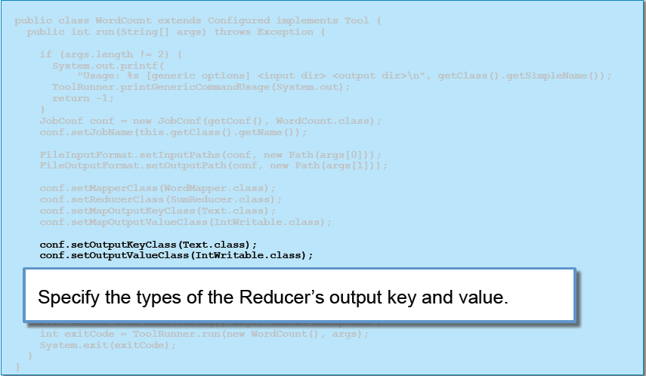
The Driver Class

Slide 88
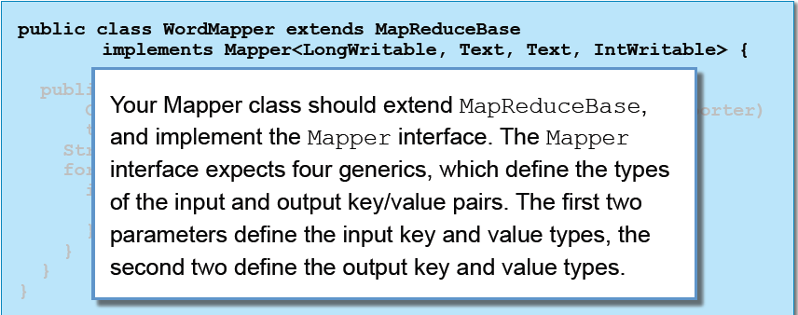
The Mapper Method

Slide 89
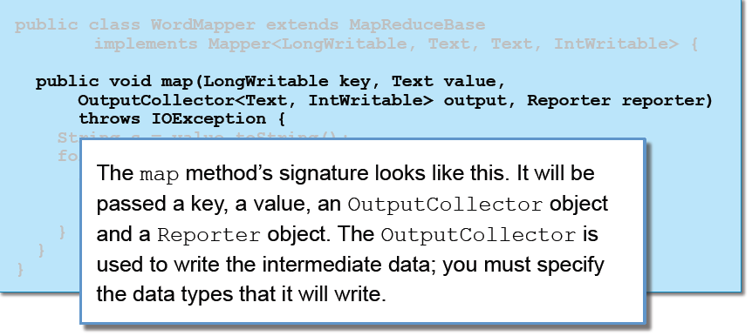
The Mapper Method

Slide 90
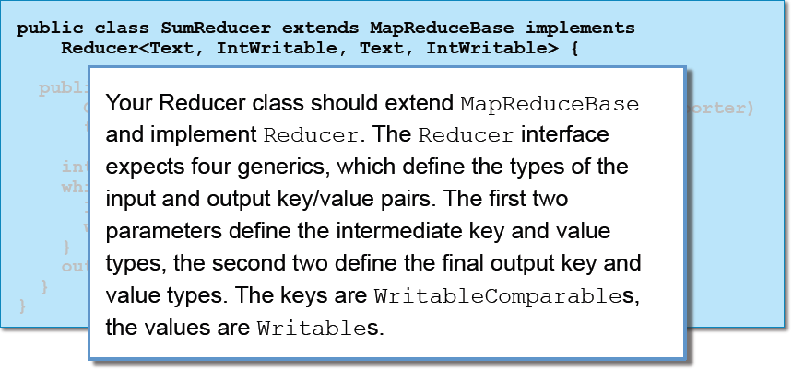
The Reducer Method

Slide 91
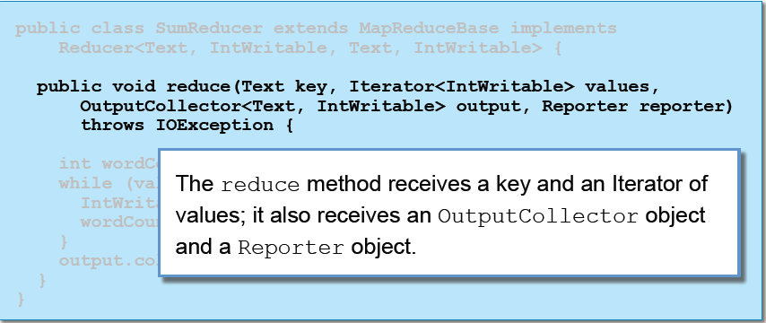
The Reducer Method

Slide 92
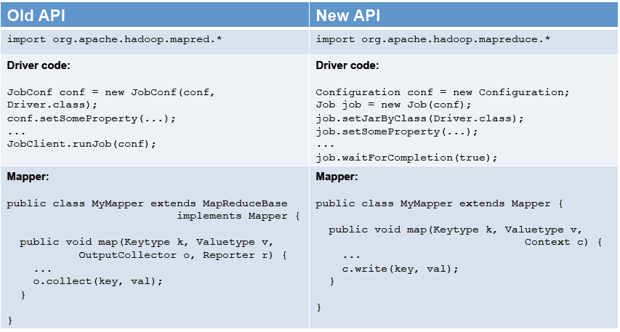
Old and New Hadoop API

Slide 93

Old and New Hadoop API

Slide 94
Agenda
Why Hadoop
Hadoop Basic Concept
Map Reduce Programming Paradigm
Hadoop Deep Dive
Map Reduce Deep Dive
Setting up Hadoop Cluster
Hadoop Hands on
Hadoop Advanced Programming
Hadoop Eco System
Beyond Hadoop

Slide 95

Map Reduce Algorithm Design
Map Reduce Revisited..

Slide 96

Map Reduce Algorithm Design
Word Count Pseudo code
How to optimize if we have thousands of documents each having millions of word !

Slide 97
Use Combiner
Combiners are an optimization in MapReduce that allow for local aggregation before the shuffle and sort phase
One can think of combiners as “mini-reducers" that take place on the output of the mappers, prior to the shuffle and sort phase
Each combiner operates in isolation and therefore does not have access to intermediate output from other mappers
The combiner can emit any number of key-value pairs, but the keys and values must be of the same type as the mapper output (same as the reducer input)
In cases where an operation is both associative and commutative (e.g., addition or multiplication), reducers can directly serve as combiners. In general, however, reducers and combiners are not interchangeable

Slide 98

Combiner vs In Mapper Aggregation
combiners in Hadoop are treated as optional optimizations, so there is no guarantee that the execution framework will take advantage of all opportunities for partial aggregation.
such indeterminism is unacceptable for large data set
Perform in-mapper combining

Slide 99

Improvement to in-Mapper Combination
What is the different from previous one ?
Will the In Mapper combination work for millions of document ? What will be potential issue you may face ? Hint , where you keep the associative array ?

Slide 100
Careful with In-Mapper Combination
It breaks the functional programming underpinnings of MapReduce, since state is being preserved across multiple input key-value pairs.
Second, there is a fundamental scalability bottleneck associated with the in-mapper combining pattern. It critically depends on having sufficient memory to store intermediate results until the mapper has completely processed all key-value pairs in an input split.
How to solve this memory issues ?

Slide 101
One more Example ?
I promise it will be interesting !!!

Slide 102
Problem Statement
A large user log from a popular website, where keys represent user ids and values represent some measure of activity such as elapsed time for a particular session. the task would correspond to computing the mean session length on a per-user basis, which would be useful for understanding user demographics

Slide 103
Mean Calculation
What will be the Map and Reduce Algorithm ?

Slide 104

Mean Calculation
Now think of a Combiner ….Can we use the Same Reducer as Combiner ?

Slide 105
Mean Calculation
Mean is not an associative operation
So our Combiner will be different than Reducer …
What we need to do to make Combiner Work ?

Slide 106

Mean Calculation
Will this algorithm work ?

Slide 107

Mean Calculation

Slide 108

Mean Calculation
Move the Combiner Logic to In-Map Combination..

Slide 109

Common Map Reduce Algorithm

Slide 110

Sorting

Slide 111

Sorting
Single Reducer , it is fine.
What will happen if there are Multiple Reducers ?

Slide 112
Custom Practitioner
We need to implement custom partition function such that
If k1 < k2, partition(k1) <= partition(k2)

Slide 113

Sorting as speed test of Hadoop Cluster

Slide 114

Searching

Slide 115

Indexing

Slide 116

Machine Learning : Mahout

Slide 117
Term Frequency – Inverse Document Frequency
Term Frequency – Inverse Document Frequency (TF-IDF)
– Answers the question “How important is this term in a document”
Known as a term weighting function
– Assigns a score (weight) to each term (word) in a document
Very commonly used in text processing and search
Has many applications in data mining

Slide 118
TF-IDF Motivation
Merely counting the number of occurrences of a word in a document is not a good enough measure of its relevance
If the word appears in many other documents, it is probably less relevance
Some words appear too frequently in all documents to be relevant – Known as ‘stopwords’
TF-IDF considers both the frequency of a word in a given
document and the number of documents which contain the word

Slide 119

TF-IDF

Slide 120

What we Need ?

Slide 121

TF-IDF Algorithm

Slide 122

TF-IDF Job 1

Slide 123

TF-IDF Job 2

Slide 124

TF-IDF Job 3

Slide 125
Word Co-occurrence
Used in many Text Processing based Machine Learning techniques.
Has application on information retrieval
Represents a specific instance of the task of estimating distributions of discrete joint events from a large number of observations
Application in Retail domain… Similarity between items.

Slide 126

Solution 1 : “PAIRS”

Slide 127

Solution 1 : “STRIPES”
Isn’t this concept look similar to something we learned earlier ?

Slide 128
Agenda
Why Hadoop
Hadoop Basic Concept
Map Reduce Programming Paradigm
Hadoop Deep Dive
Map Reduce Deep Dive
Setting up Hadoop Cluster
Hadoop Hands on
Hadoop Advanced Programming
Hadoop Eco System
Beyond Hadoop

Slide 129

Hadoop Secondary Sort
Consider the example of sensor data from a scientific experiment: there are m sensors each taking readings on continuous basis, where m is potentially a large number. A dump of the sensor data might look something like the following
Suppose we wish to reconstruct the activity at each individual sensor over time. What will our Map Reduce Logic ?

Slide 130

Hadoop Secondary Sort
A MapReduce program to accomplish this might map over the raw data and emit the sensor id as the intermediate key, with the rest of each record as the value:
This would bring all readings from the same sensor together in the reducer. However, since MapReduce makes no guarantees about the ordering of values associated with the same key, the sensor readings will not likely be in temporal order
How we can solve this problem ? Sort within Reducer ?
What if we are working with a high frequency sensor or sensor readings over a long period of time? What if the sensor readings themselves are large complex objects?

Slide 131

Hadoop Secondary Sort
This is a common problem, since in many applications we wish to first group together data one way (e.g., by sensor id), and then sort within the groupings another way (e.g., by time).
there is a general purpose solution, which we call the “value-to-key conversion" design pattern. The basic idea is to move part of the value into the intermediate key to form a composite key, and let the MapReduce execution framework handle the sorting

Slide 132

Hadoop Secondary Sort
We must dene the intermediate key sort order to first sort by the sensor id (the left element in the pair) and then by the timestamp (the right element in the pair)
We must also implement a custom partitioner so that all pairs associated with the same sensor are shuffled to the same reducer

Slide 133

Hadoop Secondary Sort

Slide 134
Hadoop Serialization Format
Is a flat file consisting of binary key/value pairs. It is extensively used in MapReduce as input/output formats. It is also worth noting that, internally, the temporary outputs of maps are stored using SequenceFile.
The SequenceFile provides a Writer, Reader and Sorter classes for writing, reading and sorting respectively.
Good fit for combining small files into one sequence file..Like key as the fileName and value as file data.
There are 3 different SequenceFile formats:
Uncompressed key/value records.
Record compressed key/value records - only 'values' are compressed here.
Block compressed key/value records - both keys and values are collected in 'blocks' separately and compressed.

Slide 135


Hadoop SequenceFileFormat

Slide 136
Hadoop Serialization Format
SequenceFiles are useful in that they solve two problems that make using MapReduce challenging; they’re natively splittable, and they also have built-in support for compression, which makes it transparent to the user. The thorn in the side of SequenceFiles is their lack of support outside of Java, which limits what other tools you can use with them. If your data mostly stays in HDFS, however, and is processed with MapReduce (or Hive/ Pig), SequenceFiles may be what you need.
We will see the Compression in a while !

Slide 137

Hadoop Compression

Slide 138

Hadoop Compression

Slide 139


Hadoop Compression

Slide 140


Hadoop Compression

Slide 141
Agenda
Why Hadoop
Hadoop Basic Concept
Map Reduce Programming Paradigm
Hadoop Deep Dive
Map Reduce Deep Dive
Setting up Hadoop Cluster
Hadoop Hands on
Hadoop Advanced Programming
Hadoop Eco System
Beyond Hadoop

Slide 142

Hadoop Eco System

Slide 143

Hadoop Data Loader : Flume

Slide 144

Hadoop Data Loader : Sqoop

Slide 145

Hadoop Data Loader : Use Cases

Slide 146

Hadoop Data Loader at ELT: Use Cases

Slide 147

Hadoop High Level Language: Hive & Pig Motivation

Slide 148

Hadoop High Level Language: Hive & Pig

Slide 149

Hadoop High Level Language: Hive & Pig

Slide 150

Hadoop Columnar Database : HBase

Slide 151

Hadoop Columnar Database : HBase

Slide 152


Hadoop Machine Learning : Mahout

Slide 153
Hadoop Workflow : Oozie
Oozie is a Java Web-Application that runs in a Java servlet-container - Tomcat and uses a database to store:
Workflow definitions
Currently running workflow instances, including instance states and variables
Oozie workflow is a collection of actions (i.e. Hadoop Map/Reduce jobs, Pig jobs) arranged in a control dependency DAG (Direct Acyclic Graph), specifying a sequence of actions execution

Slide 154
Agenda
Why Hadoop
Hadoop Basic Concept
Map Reduce Programming Paradigm
Hadoop Deep Dive
Map Reduce Deep Dive
Setting up Hadoop Cluster
Hadoop Hands on
Hadoop Advanced Programming
Hadoop Eco System
Beyond Hadoop

Slide 155
Big FAST Data
Hadoop is high latency framework. Can not support Real Time Query. It is high throughput system.
Need framework for performing analytics in Big FAST data.
Storm by twitter.
Kafka by linked in.
Complex Event Processing Library Esper.
Impala : Real Time Query engine on Hadoop by Cloudera.

Slide 156
NoSQL World
Cassandra : Columnar Database
Mongo DB , CouchDB : Document Oriented Database
Neo4J: Graph Database
Distributed Cache for Big Data (CouchBase)

Slide 157
Distributed Search Engine
SolrCloud
ElasticSearch

Slide 158

Next Generation Hadoop : YARN
One of the Major bottleneck in present Hadoop architecture is JobTracker.

Slide 159
Thank You
References :
Google Cluster Computing and Map Reduce : http://code.google.com/edu/submissions/mapreduce-minilecture/listing.html
Cloudera University : http://university.cloudera.com/
Book : Hadoop in Practice by Alex Holms
Book : Hadoop the Definitive Guide by Tom White
Understanding Hadoop Cluster and Network
http://bradhedlund.s3.amazonaws.com/2011/hadoop-network-intro/Understanding_Hadoop_Clusters_and_the_Network-slides_and_text_bradhedlund_com.pdf
Data-Intensive Text Processing with MapReduce (http://lintool.github.com/MapReduceAlgorithms/MapReduce-book-final.pdf)
Jimmy Lin and Chris Dyer
A Storage Architecture for Data Intensive Computing
http://www.cs.rice.edu/CS/Architecture/docs/phdthesis-shafer.pdf

